Slide 1
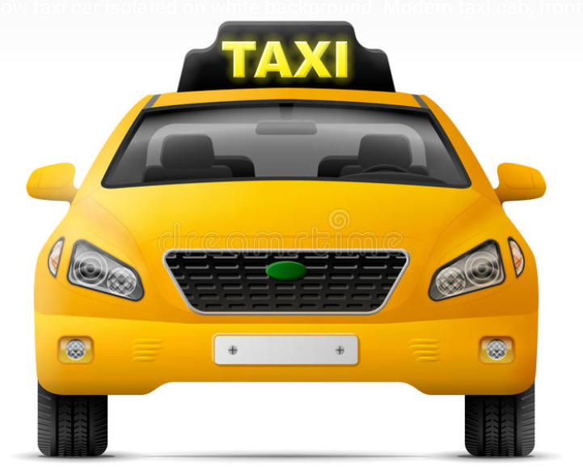
Reinforcement Learning:​ Self-Driving Taxi
Team Albert
June 15th, 2021

Slide 2
Executive Summary
OBJECTIVE​​
Teach a Taxi to pick up and drop off passengers at the right locations on any random start point
Try different experiments to understand how different RL techniques will impact the learning performance ​
EXPERIMENTS
Train a Taxi on 5x5, 6x6, 8x8 and 10x10 map with Reinforcement Q-Learning ​
Exploration of tuning epsilon and learning rate to improve performance​
Train Taxi on 5x5 with linear, non-linear function approximation​ and model-based RL
Add an extra taxi and turn it into a two agents RL problem
RESULTS
Successfully trained taxi working on different size of maps use Q-learning
Function approximation does not fit well in this taxi use case
Successfully trained two agents working on the same map

Slide 3
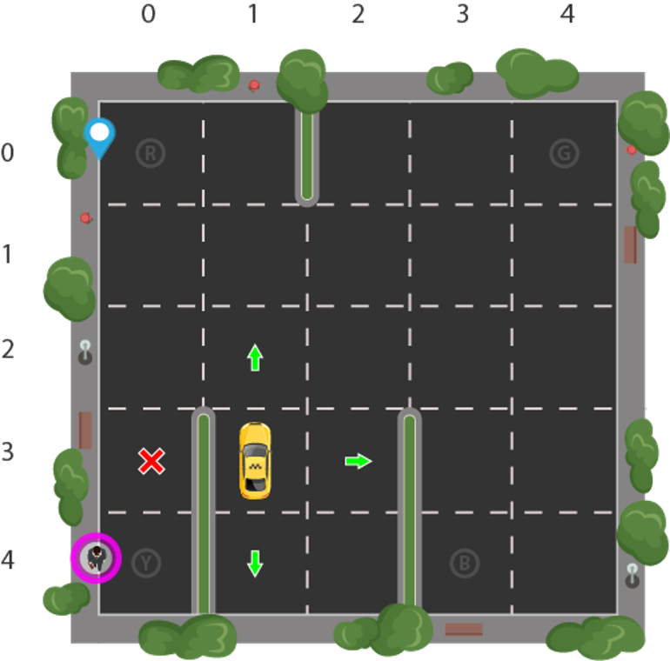
Example Design: Self-Driving Cab (OpenAI Gym)
Reasons for our selection
Easy to understand and implement​
Able to change the source environment and configuration​
Able to add extra agent on the same map to expand problems

Slide 4
Example Design: Self-Driving Cab (OpenAI Gym)
R
G
Taxi Learning Task
Transport passenger to four different locations at any random start point:
R (0 , 0)
G (0 , 4)
Y (4 , 0)
B (4 , 3)
The passenger can be picked up or dropped off at these 4 locations.
(On the right graph showing passenger in location Y and wish to go to R )
Y
B

Slide 5
Example Design: Self-Driving Cab (OpenAI Gym)
Action Space
- 0 = south - 1 = north - 2 = east - 3 = west - 4 = pickup - 5 = drop off
Rewards
- All movement actions have a -1 reward
- A wrong pickup or drop-off action will get a penalty of 1 and a reward of -10
- Successfully dropping off a passenger at the right destination will get a reward of 20

Slide 6
Example Design: Self-Driving Cab (OpenAI Gym)
State Space
5 x 5 grid = 25 possible taxi
4 destinations: R, G, Y, B
5 passenger locations:
R, G, Y, B + In_the_Taxi
Total possible states:
5 x 5 x 4 x 5 = 500

Slide 7
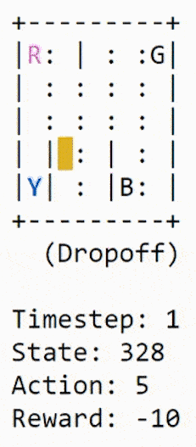
Before training with RL​
Passenger is in Y and the destination is R​
We can see the taxi has difficulty in finishing the task within a short time​ span

Slide 8
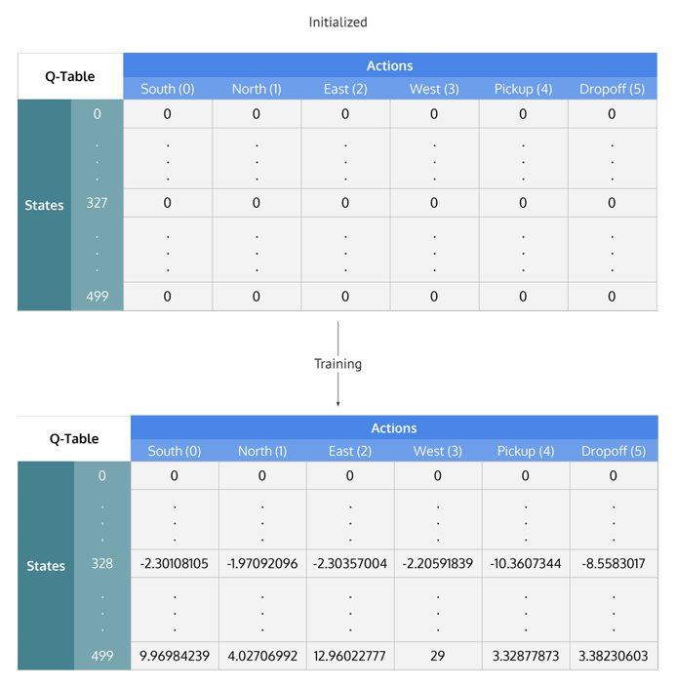
Experiment 1 - Training with RL Q-Learning​
Parameters:
- α = 0.1​, γ = 0.9, ε = 0.2
Train for 100,000 Episode​s with Q-learning
- Initiate Q Table as (500,6) zero matrix
- Each Epoch:
- Randomly reset Taxi location and status
- Update Q value:
new_value = (1 - α) * old_value + α * (reward + γ * next_max)

Slide 9
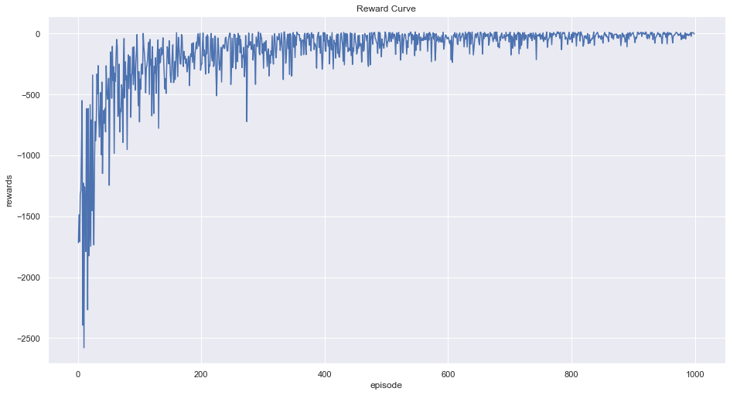
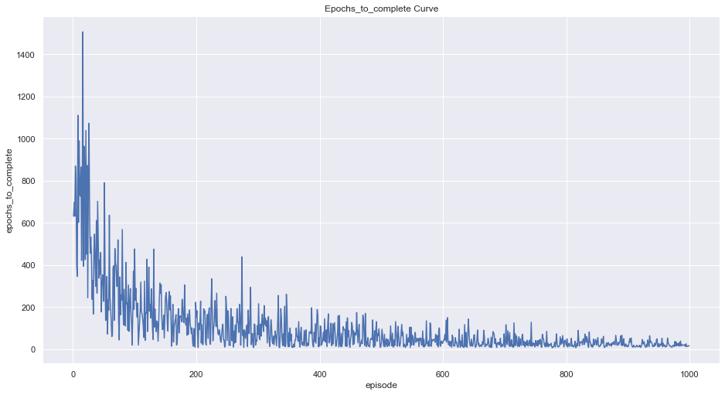
Training with RL Q-Learning – Learning Curve​
Reward curve starts to converge after 1000 steps
Similarly, epoch to complete the task start to converge after 1000 steps

Slide 10
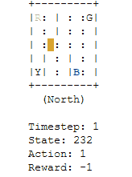
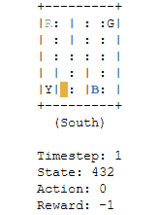
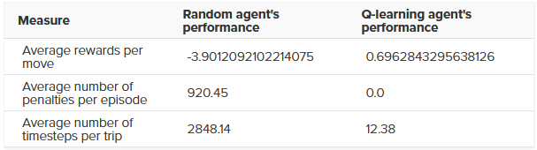
Experiment 1 - Training with RL Q-Learning​
After Q-learning:
Penalties = 0 --- no wrong pickup/drop-off action
Finished the same episode(pickup passenger from B and drop-off at R) in 16 steps
Reward = 20 --- Successfully drop-off passenger at R
Q-Learning

Slide 11
Experiment 2
We want to explore how different parameters (eg. α, ε) will affect the RL learning

Slide 12
Experiment 2 – Hyper-parameter tunning ​
# Hyper-parameters​
α = 0.1​, γ = 0.9, ε = 0.2
α = [0.01, 0.1, 0.5, 0.9]​
γ = [0.9, 1]​
ε = [0, 0.2, 0.5]
​

Slide 13
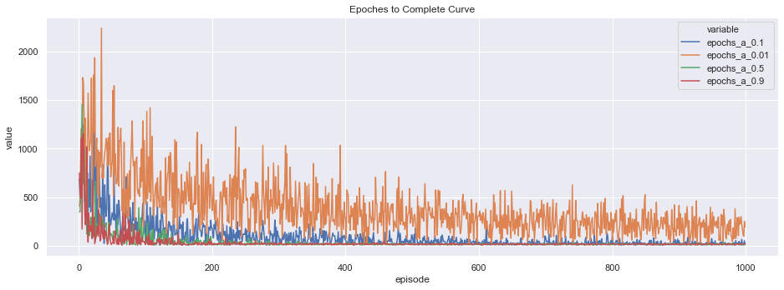
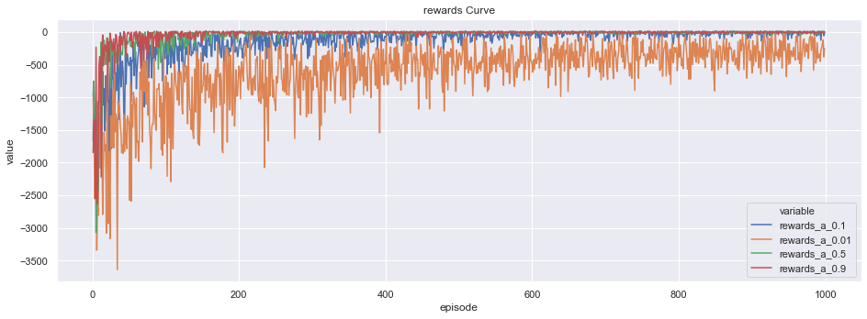
Experiment 2 – Hyper-parameter tunning ​
# Hyper-parameters​
α = [0.01, 0.1, 0.5, 0.9]​
γ = 0.9
ε = 0.2

Slide 14
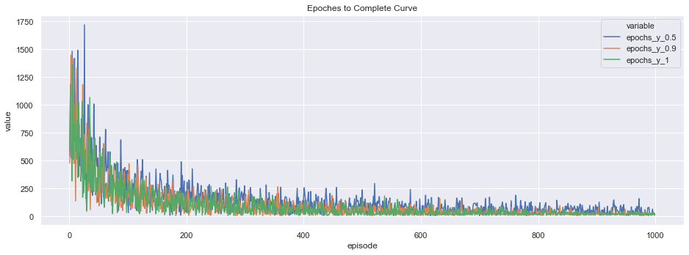
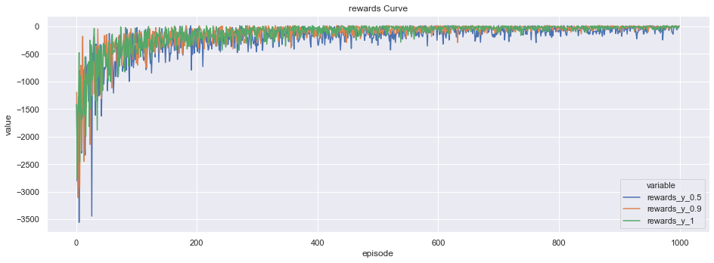
Experiment 2 – Hyper-parameter tunning ​
# Hyper-parameters​
α = 0.1
γ = [0.5, 0.9, 1]
ε = 0.2

Slide 15
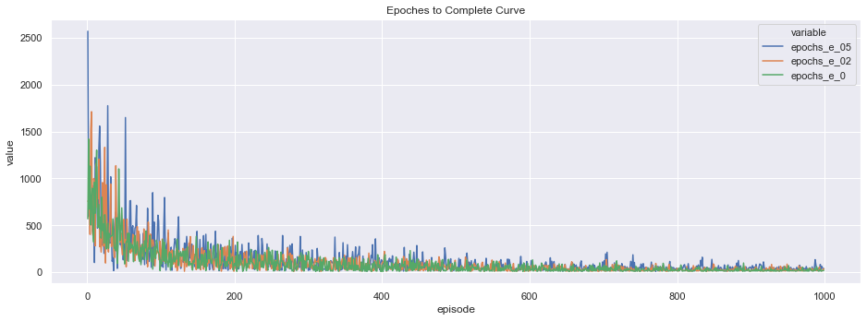
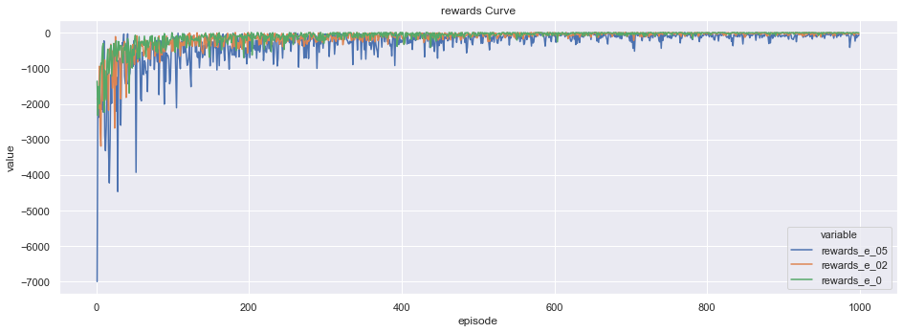
Experiment 2 – Hyper-parameter tunning ​
# Hyper-parameters​
α = 0.1​
γ = 0.9
ε = [0, 0.2, 0.5]

Slide 16
Experiment 3
We want to explore how learning and optimal policy would change when increase the map size

Slide 17
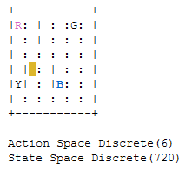
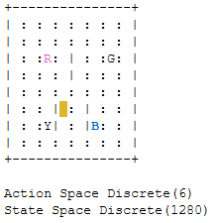
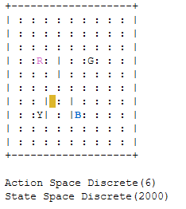
Experiment 3 – Expand the map size with extra space​​
Modify the Open Ai source code to expand the map​
State space increased from the original 500 to 720, 1280, and 2000
Basically, we want to compare the learning curve when the map is expanded
6 x 6
8 x 8
10 x 10

Slide 18
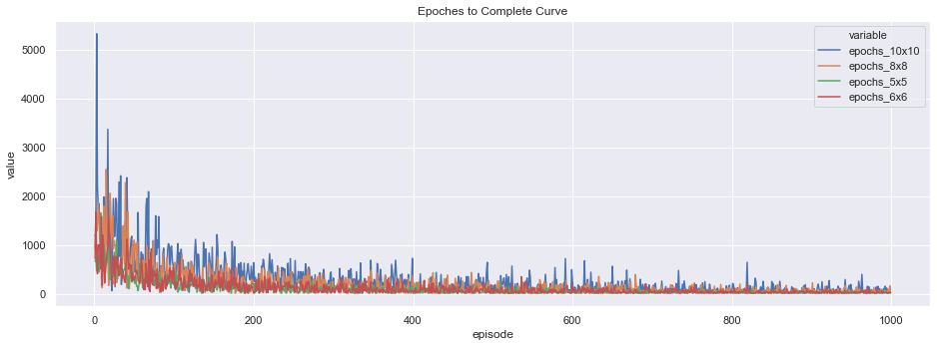
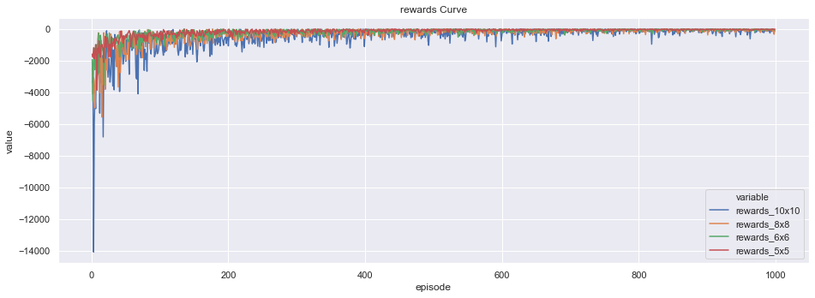
Experiment 3 – Expand the map size with extra space​​

Slide 19
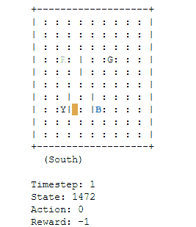
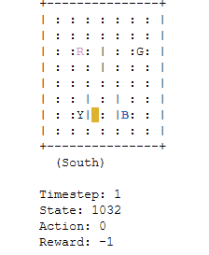
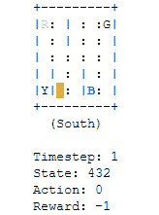
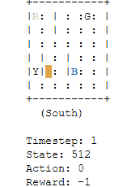
Experiment 3 – Expand the map size with extra space​
The learning would take longer to converge when map is expanded
The Agent learned a new optimal path utilizing the added map space.​

Slide 20
Experiment 4
Explore function approximation technique to speed up learning
Linear Q-Learning Function Approximation
Non-Linear Q-Learning Function Approximation
Model Based Reinforcement Learning

Slide 21
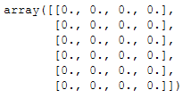
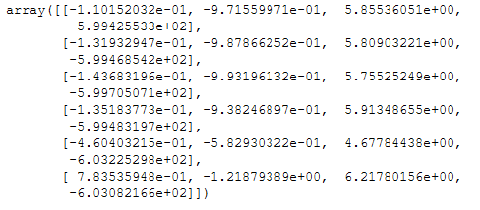
Experiment 4 – Model Free Function Approximation
Linear Q-Leaning Function Approximation
State Feature: [taxi row, taxi column, pass location, destination ] for 6 actions
Example: at state [2, 2, 0, 3] can have 6 actions
Weight matrix dimension is (6,4)
Weight updated every epoch

Slide 22
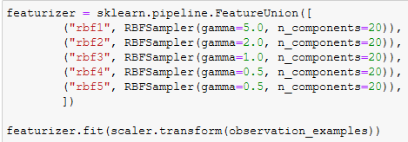
Experiment 4 – Non-Linear Function Approximation
Non-linear Q-Leaning Function Approximation
State Feature: [taxi row, taxi column, pass location, destination ] for 6 actions
Example: at state [2, 2, 0, 3] can have 6 actions
Kernel transformation into 100 dimension - > ( try to capture non-linear relationship)
Weight matrix dimension is (6,100)
Standard Scaler
[2, 2, 0, 3]
1x4 Matrix
[New State Feature]
1x100 Matrix

Slide 23
Experiment 4 – SGDregressor Reinforcement Learning
Model-Based Reinforcement Learning
State Feature: [taxi row, taxi column, pass location, destination ] for 6 actions
Example: at state [2, 2, 0, 3] can have 6 actions
Weight matrix dimension is (6,4) -> 6 SGDregressor Models
Models would use state feature to predict which action can maximize Q-values
Predict
6 SGDregressor
Models
Update

Slide 24
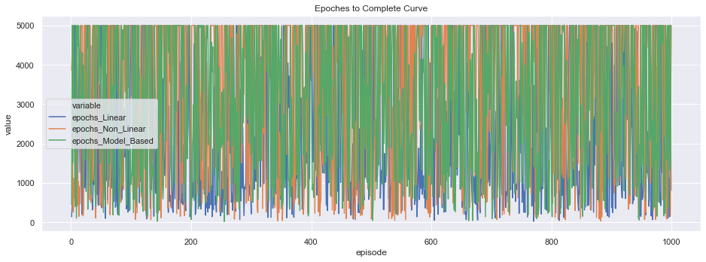
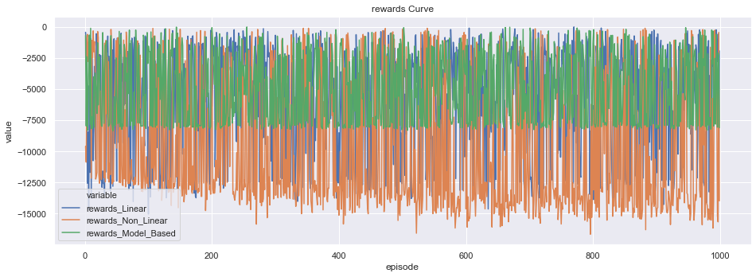
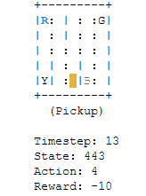
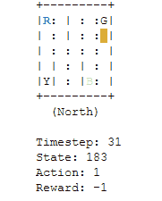
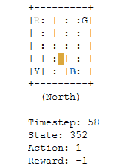
Experiment 4 – Learning Experience Comparison
Linear FA
Non-Linear FA
Linear Model Based RL

Slide 25
Experiment 5
Explore how to handle two agent problems and how additional agents would impact the learning.

Slide 26
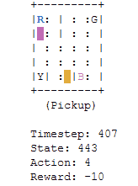
Experiment 5 – Two agent on the same map
Experiment Design
Two taxis are going to pick up different passengers on the same map
The episode will end when both taxis finishing the task
Taxi 1 View
Pre-Defined Conditions
Two taxis are going to cooperate rather than compete.
Taxis can not cross each other, one will be blocked by the other taxi, unless they are dropping or picking up passengers.

Slide 27

Experiment 5 – Two agents on the same map
Techniques to handle two agents on the same map
Share the information to one another when a taxi make any moves
Update Status
Update Status
Pull Global information
Pull Global information
Taxi 1
Taxi 2

Slide 28
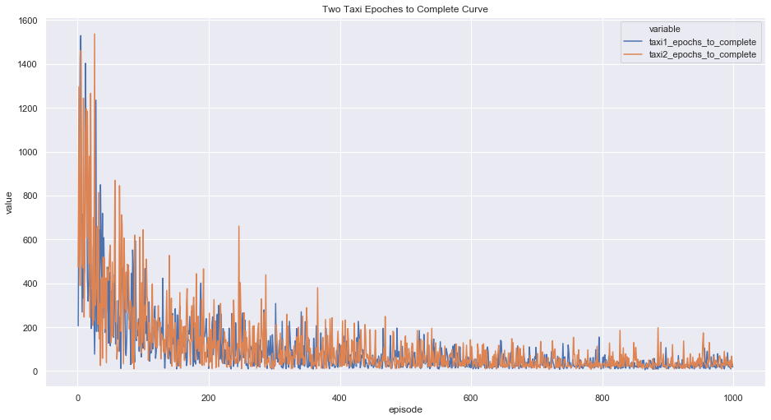
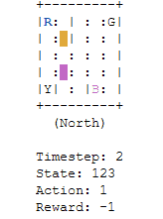
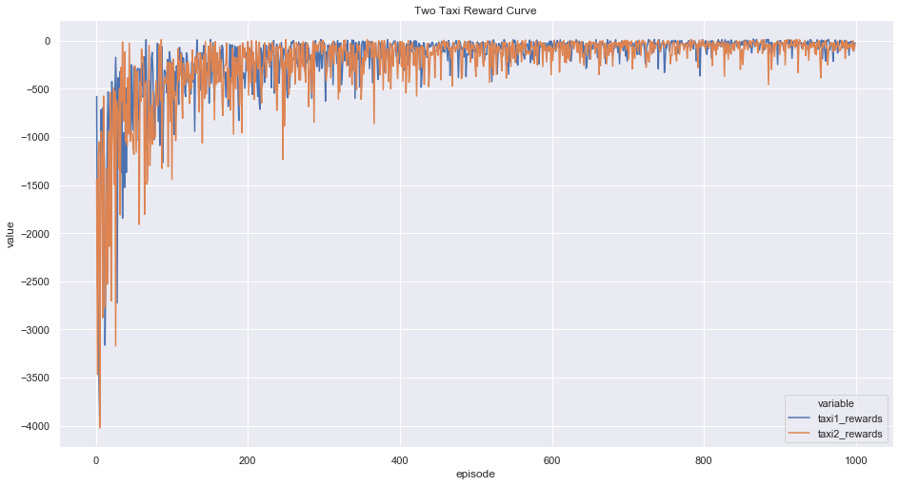
Experiment 5 – Two Agent Q-learning 10000 Epoch
Start Q-learning
End Q-learning

Slide 29
Result Learning & Application ​
Learning:
Tuning the parameters of Q-learning can speed up the learning process
Function approximation may not work well on small state problems. Need to work on feature transformation to capture non-linear relationship. Linear feature does not work well with FA.
When designing multiple agent problems, we need to consider all the possible interactions between agents. Otherwise, it is very easy to result in dead loop
Project Application
Our current model will have limitations in running on more complex maps
Cannot transfer experience to the new environment

Slide 30
Next Steps​
Change the environment more dynamic (closer to real world environment)
Randomize passenger location and destination
Randomize area of traffics
Deep Q-learning
Explore more advanced method
Tile Coding
Split map into regions and we update weights by different regions. It would be effective when the map is becoming larger
Transfer-learning
How to leverage pre-trained model to save time on learning from scratch

Slide 31

Thanks!
Any questions?

Slide 32
Appendix – Github Repo
https://github.com/BenchengW/Understand-Reinforcement-Learning-with-Simple-Example

Slide 33
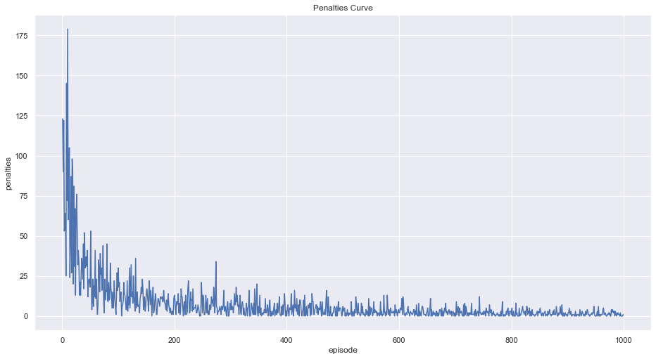
Appendix: 5x5 Q-Learning – Learning Curve​

Slide 34
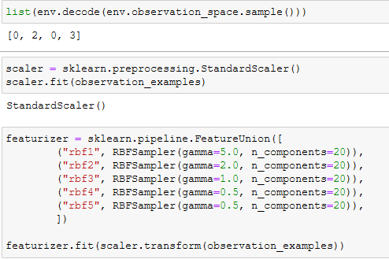
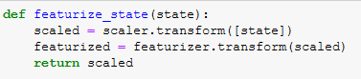
Appendix – nonlinear transformation

Slide 35
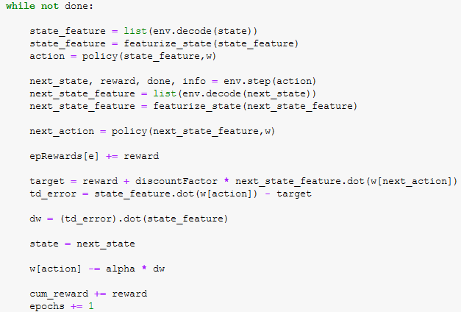
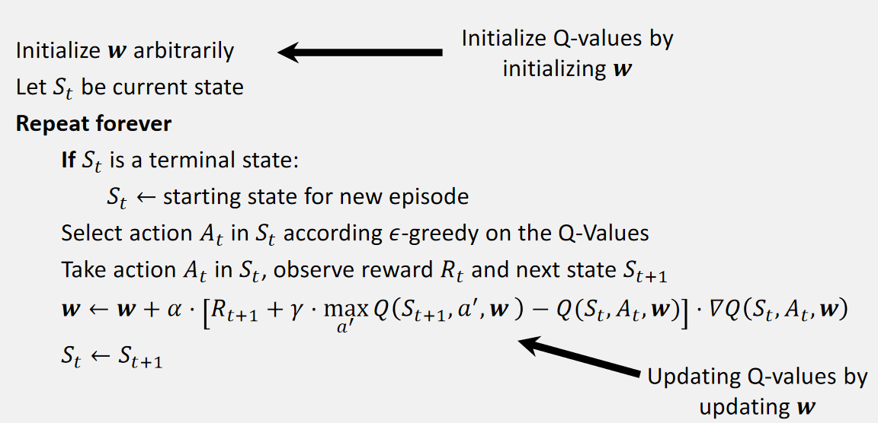
Appendix – TD Learning and Funciton Approximation

Slide 36
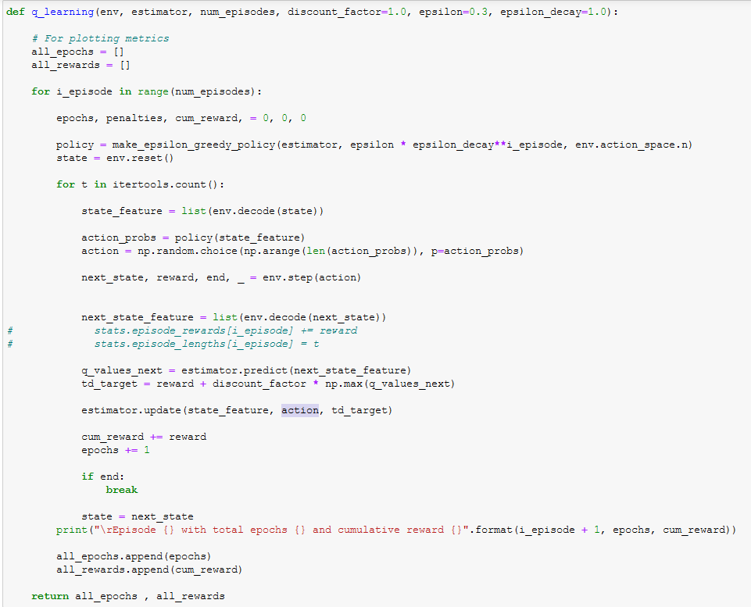
Appendix – Model Based RL

